Slide 1
Southwind Elementary School
We love you Southwind Elementary for all that you do.
There surely is no other school that’s anything like you.
Our school is so magnificent it gives us joy to say.
Staff and students are excelling each and everyday.

Slide 2
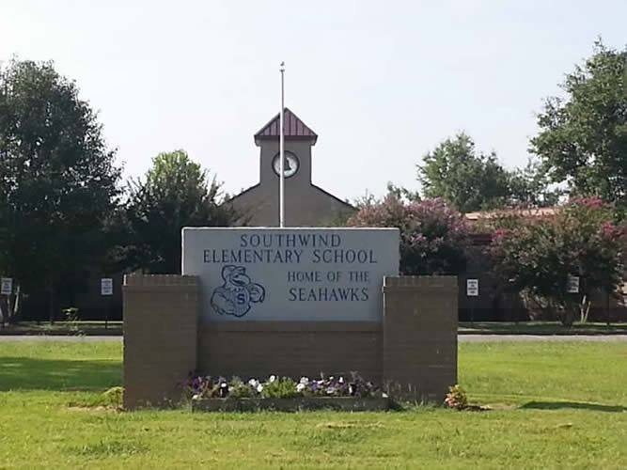
Southwind Elementary School
Southwind Elementary provides curriculum offerings which emphasize the development of basic skills and provide for student development beyond basic skills through appropriate classroom enrichment activities.

Slide 3
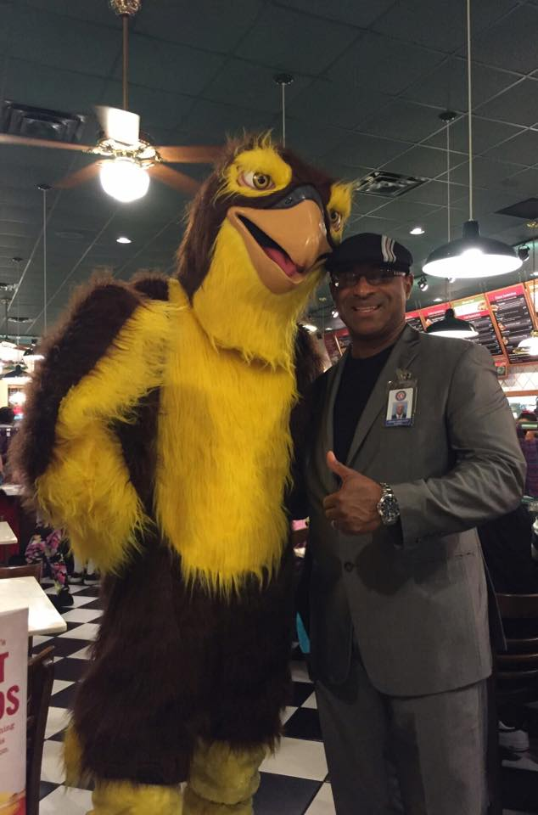
Principal Dennis Kimbrough

Slide 4
Creative thinking and problem-solving strategies are interwoven across the curriculum.

Slide 5
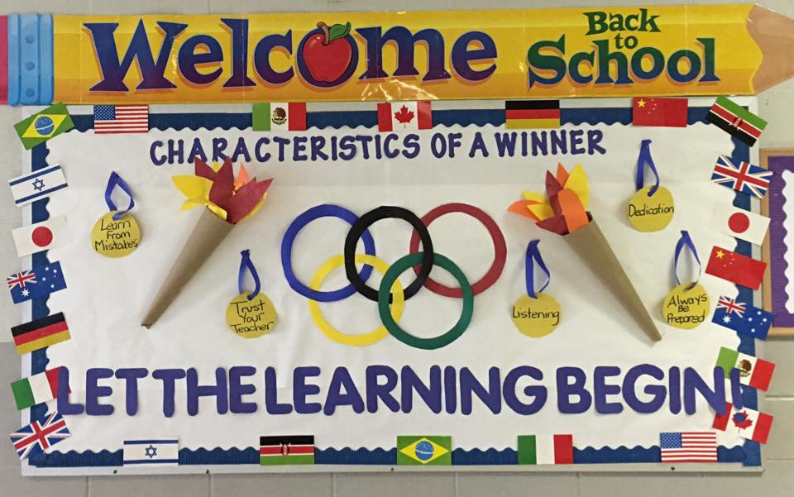
Southwind Elementary School
We offer full day Pre-K programs and special services for remedial and academically gifted students. All students receive instructional support in art, music, physical education, library skills and character building/life skills through the guidance department.

Slide 6
Cultural Arts Festival
With our increased population of students from varying cultures and ethnic backgrounds, At-Risk and ESL tutoring continue to be at the forefront of our curriculum.

Slide 7
We offer before and after school activities to enhance and extend our curriculum, as well as programs for enrichment.

Slide 8
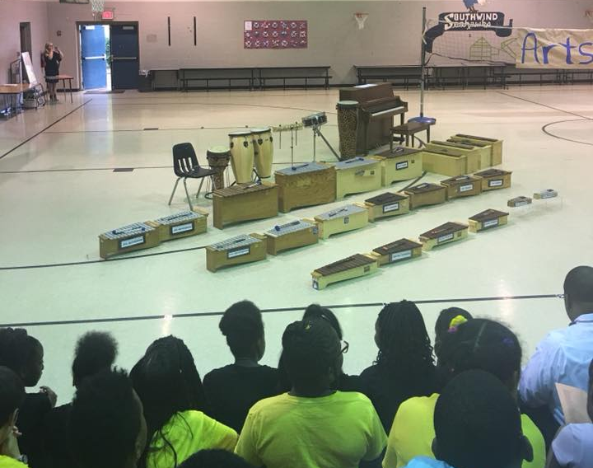
Some of the programs provided include Student Council and Choral and Orff Instruction.

Slide 9
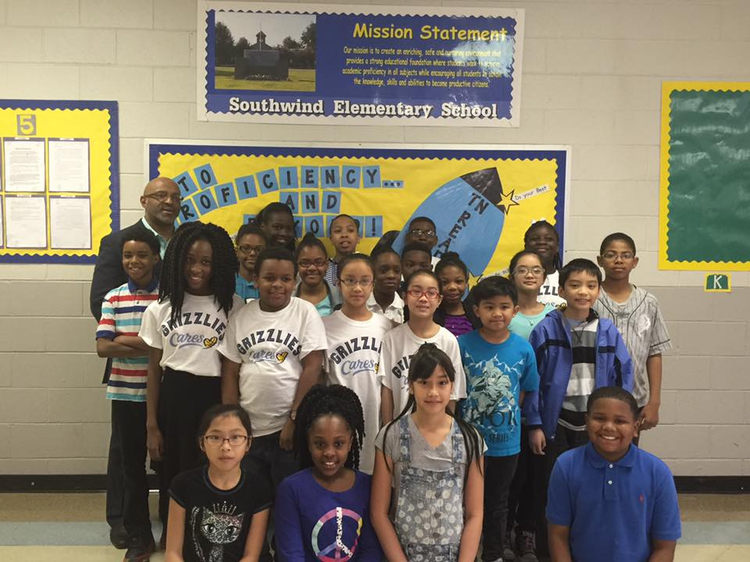
We are the Seahawks
Soaring Seahawks
And we are determined
To listen and learn
We are responsible
You should know
We walk to the right, yes
At Level Zero (shh)

Slide 10
You know we’re focused,
dreaming, reaching expectations.
You know there’s nothng,
nothing, nothing
We cannot do!

Slide 11
Math and Literacy Night
At Southwind Elementary
We are a family
Our school is the place to be
The best in Shelby County
We are the Seahawks
And we’re soaring high
We’re changing the world
One day at a time

Slide 12
We Love Dress-up Days

Slide 13
Soaring high

Slide 14
Soaring high

Slide 15
Magnificent Minds Army Against Breast Cancer, Drugs, and Anti-Bullying!

Slide 16
Fun!!!!

Slide 17
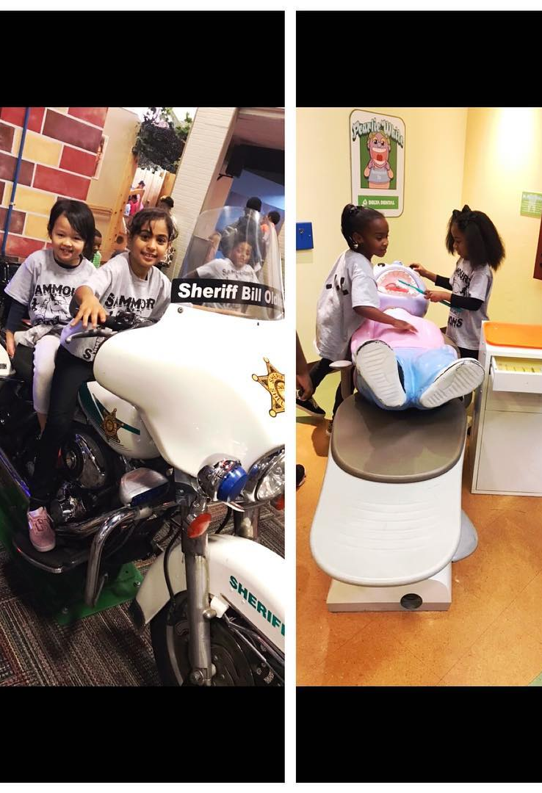
Field Trips

Slide 18
Spring Fling
We’ll keep soaring high!!!

Slide 19
Soaring high
Award Winning!

Slide 20
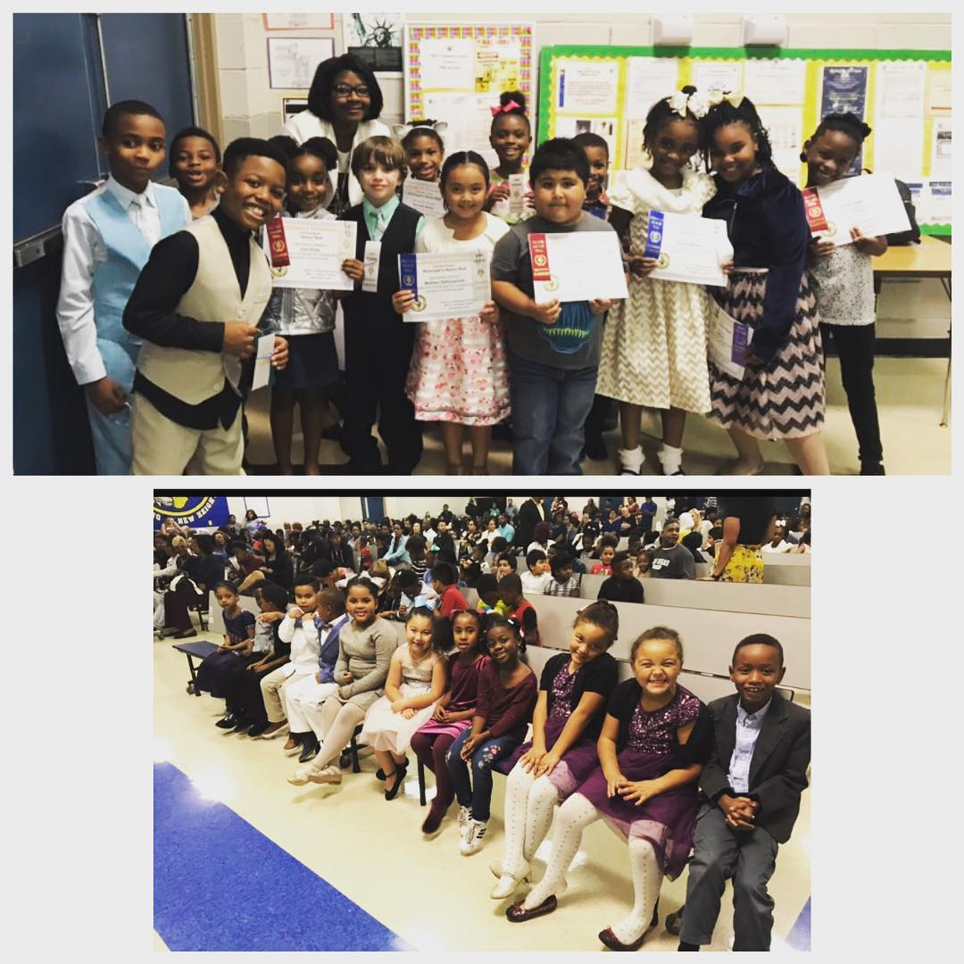
Soaring high
Honors

Slide 21
Enrichment
Memphis in May

Slide 22
Cultural Arts Fair

Slide 23
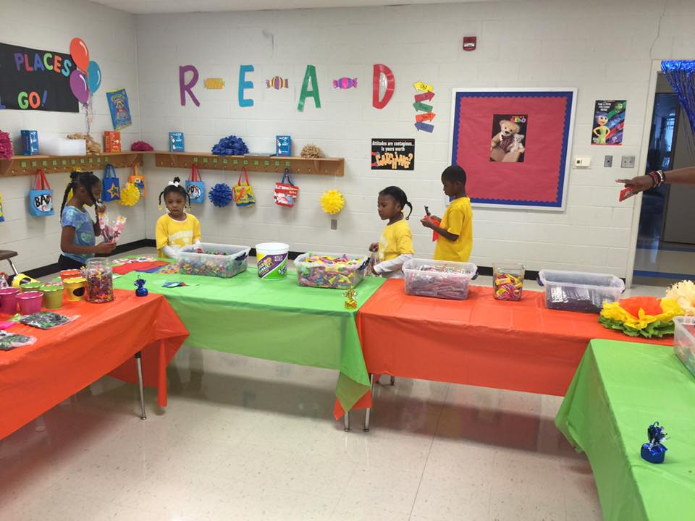
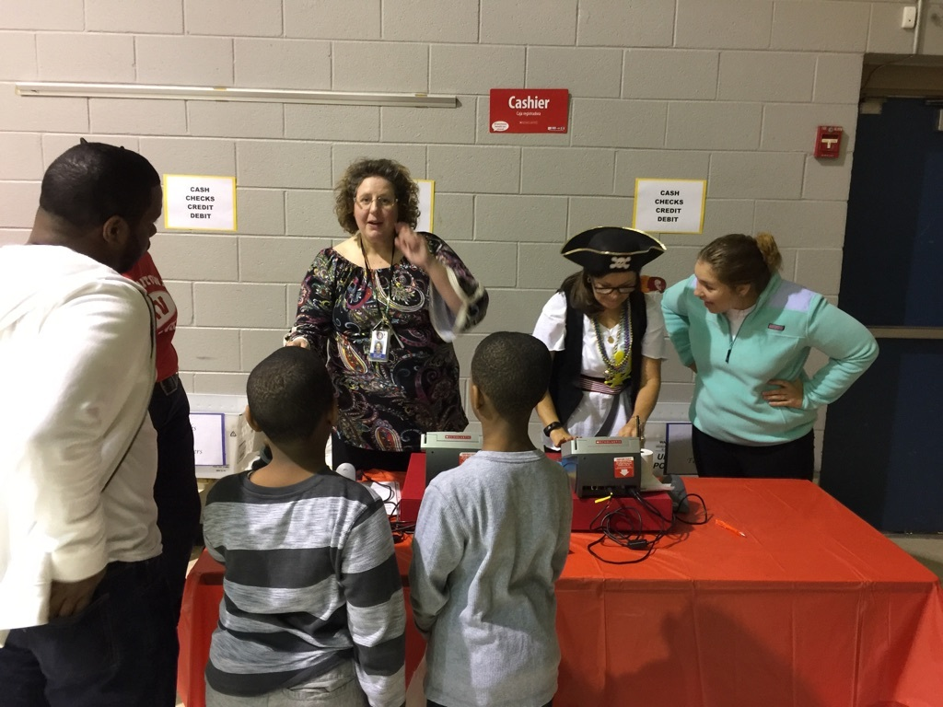
Reading is our Superpower!

Slide 24
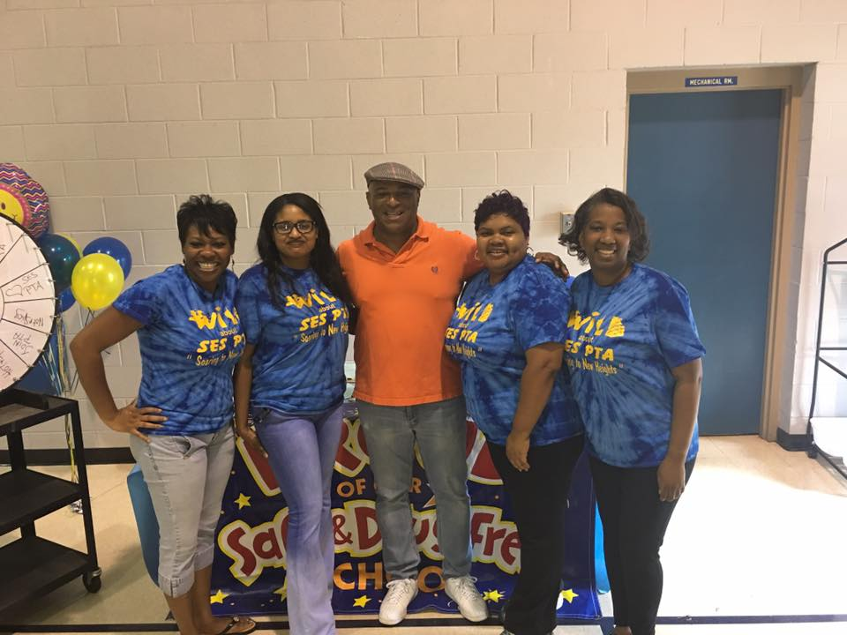
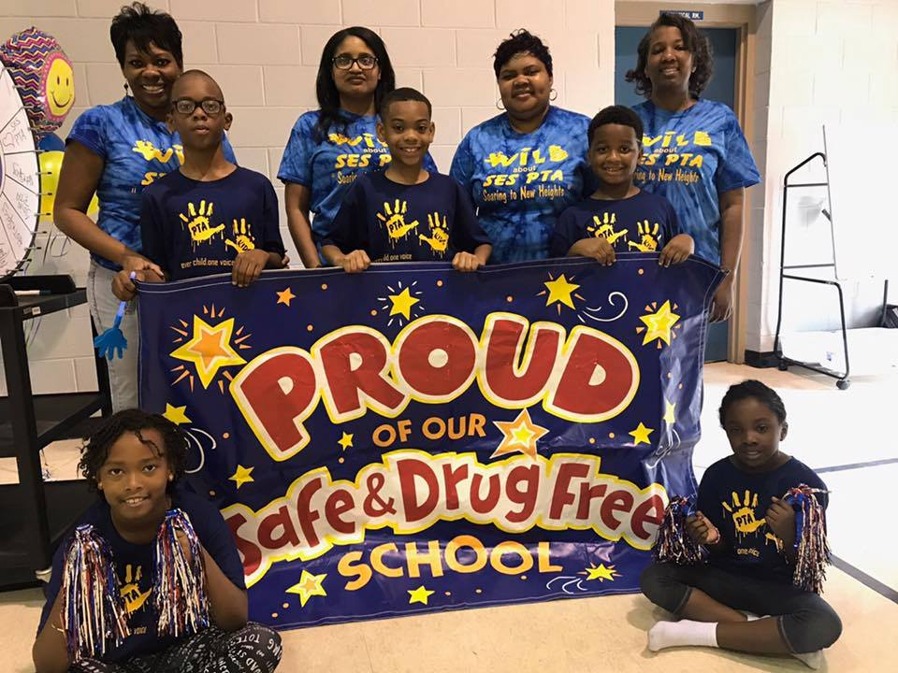
PTA

Slide 25
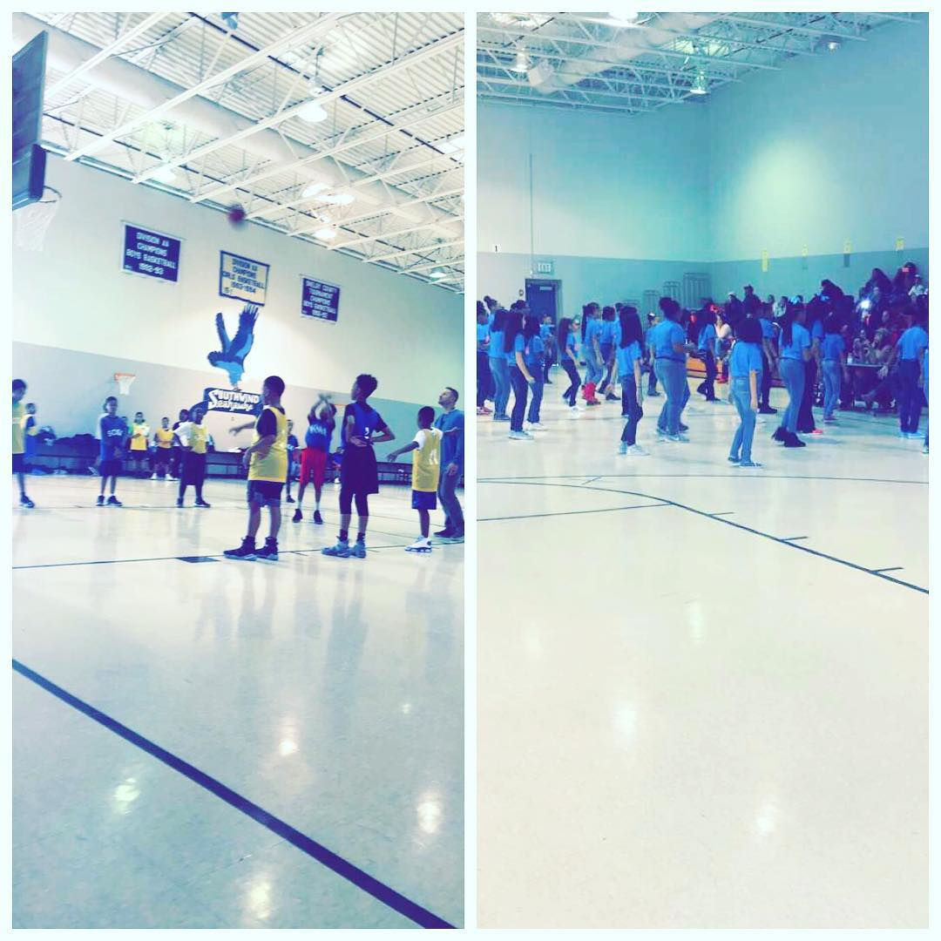
SOSA
(Students of Southwind Achievement)
Mentoring Program

Slide 26
We Love Learning!

Slide 27
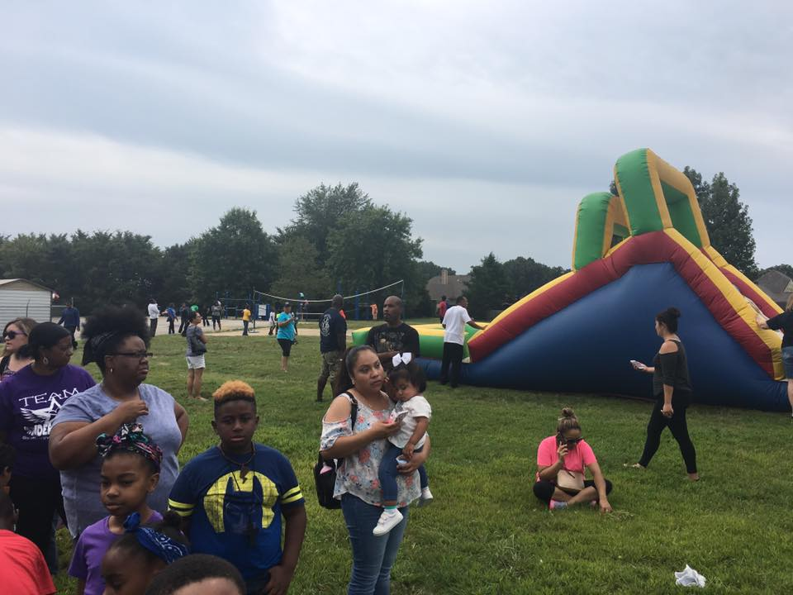
Field Day

Slide 28
Southwind Elementary School
Soaring high
We’ll keep soaring high!!!

